Slide 1

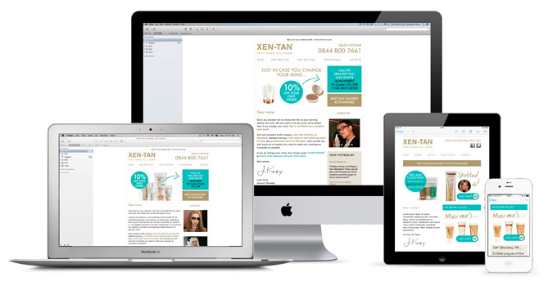
Responsive Emailer - Complex

Slide 2
Complex Things
Background Images
Gmail App Issue
Hide in Outlook or desktop version
Variables and versions
Text (.txt) Emailer
Campaign Monitor
Tera Data
Litmus
Responsive Email Checklist
Responsive Email Assumptions Doc.
Questions & Feedback

Slide 3

Background Image

Slide 4
Background Image - Code
<td align="center" class="mobileCTAwrap"> <table border="0" align="center" cellpadding="0" cellspacing="0">
<tr> <td class="mobileCTA" background="images/cta-full.png" bgcolor="#000000" width="166" height="40" valign="top" style="background-image: url(images/cta-full.png); color: #ffffff; width: 166px; height: 40px;text-align: center;"><!--[if gte mso 9]><v:rect xmlns:v="urn:schemas-microsoft-com:vml" fill="true" stroke="false" style="width:166px;height:40px;text-align: center;"><v:fill type="tile" src="images/cta-full.png" color="#000000" /><v:textbox inset="0,0,0,0"><![endif]--><div><table cellspacing="0" cellpadding="0" border="0" width="100%"><tr><td class="ctatext" align="center" valign="top" style="padding-top: 13px; text-align:center;line-height:0px;margin:0;"><a href="#" style="color: #ffffff; font-family: Arial,Helvetica,sans-serif; font-size: 13px; line-height: 15px; text-decoration: none;"><span class="fontsize14">Arial Regular,13px</span></a></td></tr></table></div><!--[if gte mso 9]></v:textbox></v:rect><![endif]--></td>
</tr>
</table>
</td>

Slide 5
Background Image - Notes
Background image can not be use with 100% width or flexible. It can be use with fix width and height only.

Slide 6

Gmail App Issue

Slide 7
Gmail App Issue
One of most popular emailer client called Gmail app don’t show mobile version in mobile. It show desktop design with 100% width which makes issues in design. For This we have made a hack which can resolve this issue and can achieve the desktop design 95% + accurate.

Slide 8
Gmail App Issue - Code
<tr><td>
<div style="display:none; white-space:nowrap; font:15px courier; color:#edecec;">- - - - - - - - - - - - - - - - - - - - - - - - - - - - - - </div>
</td></tr>
Notes:
As the display none wont work so here -------- will make the width equal to approx. 95%.

Slide 9
Hide in Outlook or desktop design

Slide 10
Hide in Outlook or desktop design
In Outlook we can not hide the content by using CSS property “display:none” only; as outlook remove this property and show the hide content. For this we have a hack and can resolve this issue.

Slide 11
Hide in Outlook or desktop design - Code
<!--[if !mso 9]><!--><div class="gmail" style="display: none; width: 0; overflow: hidden; float: left; max-height: 0; mso-hide:all;">
Hide code here…
</div><!--<![endif]-->
------------------------------------------------------------------------------------------------------------------------------
To make visible in mobile
*[class=gmail] {
display:block!important;
width:auto!important;
overflow:visible!important;
float:none !important;
height:inherit!important;
max-height:inherit!important;
}

Slide 12
Variable and Versions

Slide 13
Variables - Examples
<%user.customattribute.salutation%>
<%user.customattribute.acct_no_last_4%>
<%user.customattribute.cstm_num_3%>
<%user.customattribute.cstm_num_1%>

Slide 14
Versions - Codes
<%InsertIf expression="${((user.CustomAttribute.cstm_char_2=='F'))}" %>
<%/InsertIf%>
With Or condition
<%InsertIf expression="${((user.CustomAttribute.cstm_char_2=='FF')) || ((user.CustomAttribute.cstm_char_2==‘VV'))}" %>
<%/InsertIf%>

Slide 15
Variable

Slide 16
Text E-mailer

Slide 17
Text E-mailer
In text e-mailer we just write the content here by section as shown in PSD.
We write the same var code which we wrote in HTML e-mailer.
We write the same hyperlinks which we made in HTML e-mailer.

Slide 18
Text E-mailer

Slide 19
Campaign Monitor

Slide 20
Campaign Monitor
This is online application used for e-mailer send to multiple email ids. This is paid service so client need to pay for this.
In this application we need to make a campaign and upload the emailer data and then can send over the email ids.
https://dad-e.createsend.com/admin/

Slide 21
Tera Data

Slide 22
Tera Data
This is online application used for e-mailer send to multiple email ids. This is paid service so client need to pay for this.
In this application we need to make a campaign and upload the emailer data and then can send over the email ids.
https://secure.ecircle-ag.com/capital_one/home/login.jsp

Slide 23

Responsive Email Checklist

Slide 24
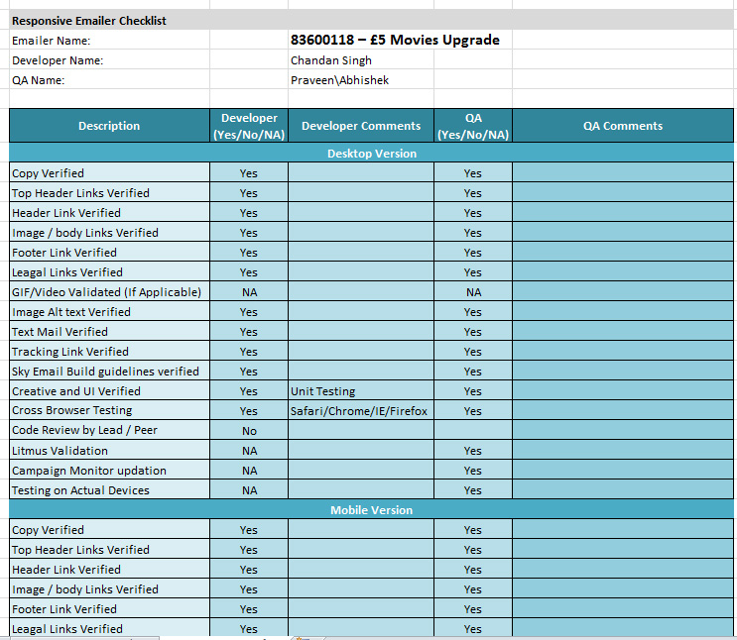
Responsive Email Checklist
We are maintaining a checklist for all responsive as well as non responsive emailer. It is mandatory for all developers to fill this checklist before sending that to QA.

Slide 25

Responsive Email Assumptions Doc.

Slide 26
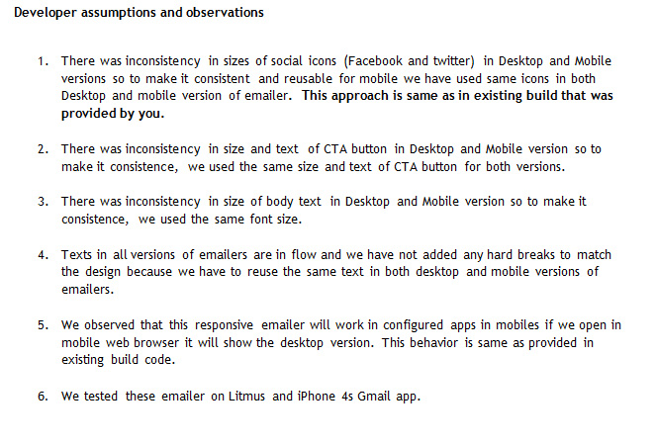
Responsive Email Assumptions Doc.
We are also maintaining a assumptions document for all responsive as well as non responsive emailer , where we write our assumptions as per email design . It is mandatory to write assumptions (if any) for all developer before sending that to QA.

Slide 27
Responsive Email View in Litmus

Slide 28
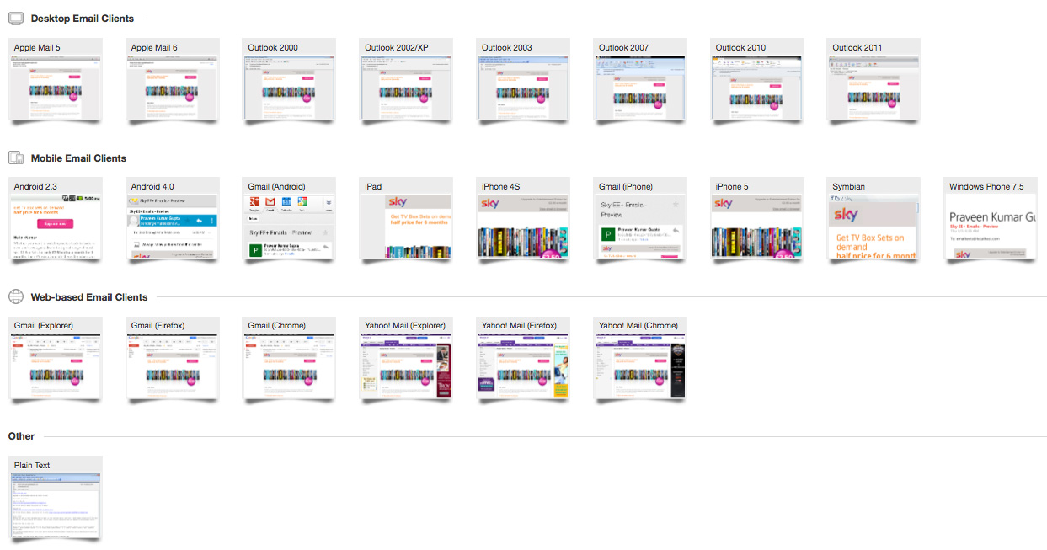
Responsive Email View in Litmus
We are using Litmus to test email.

Slide 29
Questions & Feedback

